Slide 1

X-Mart
Retail Sales Analysis 2023

Slide 2
Contents
Data familiarisation
Data Analysis
Insights and Recommendations

Slide 3
Data familiarisation
X-Mart store wants to analyse their sales, patterns and customer behaviour in the year 2023.
The short summary of provided data is given below.
Column Name | Description
Transaction ID | Unique ID for every transaction
Date | Date which transaction happened
Customer ID | Unique Customer ID
Gender | Gender of customer. Either Male or Female
Age | Age of customer
Product category | Category of customer purchased product
Quantity | Quantity purchased
Price per unit | Price of per product
Total amount | Price per unit * Quantity=Revenue
After data cleaning using Power Query editor we added Month name, Day name and Month number. Also categorized age to 3 groups as ’18-20’, ’30-49’ and ’50 plus’

Slide 4
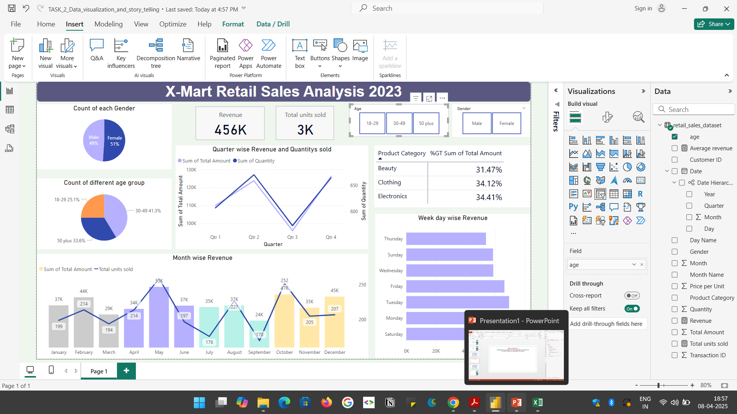
Data Analysis
What is the total revenue that the store generated in the year 2023
Which age group and which gender shows high purchasing behaviour?
Among the all customers Females shows higher amount of purchasing behaviour.
Highest number of customers falls in the age group ‘30-49’
The store generated a revenue of $ 456000 an sold more than 3000 units of products

Slide 5
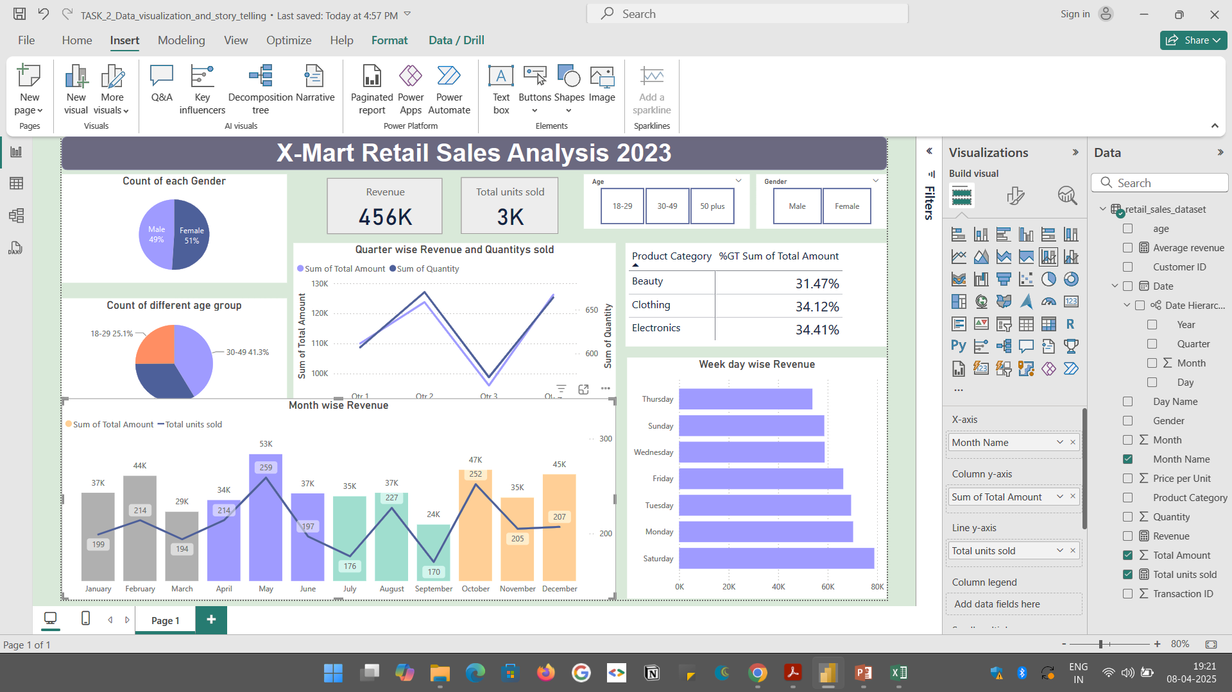
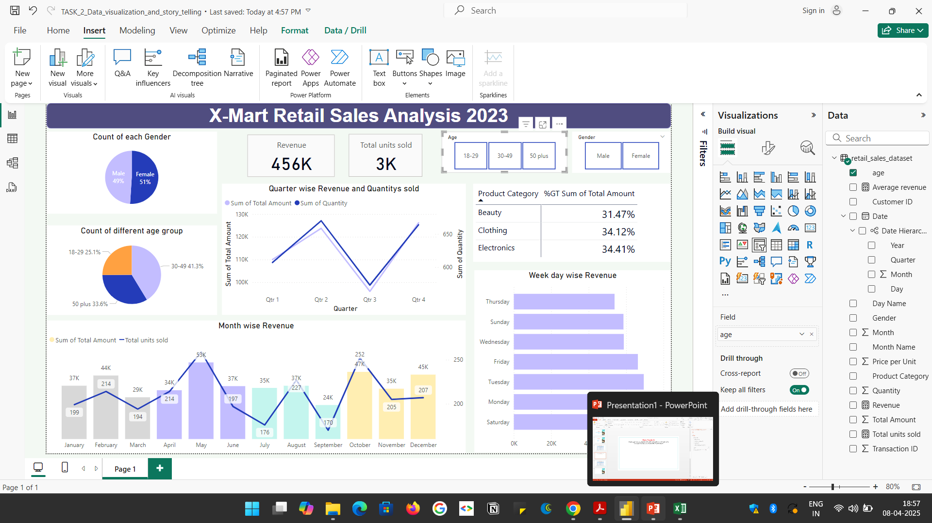
Data Analysis
In which month, store performed at its peak and store performed poorly ?
Store performed it’s best in the month ‘May’. In may, store generated the highest revenue $53000 and sold highest number of products(253).
Store performance is poor in the month of September. Only sold 170 pieces of product with a revenue of $ 24000.
This change is more visible in the quarterly sales. Second Quarter (April, May, June) produced high revenue, where Third Quarter (July, August, September) showed the least performance

Slide 6
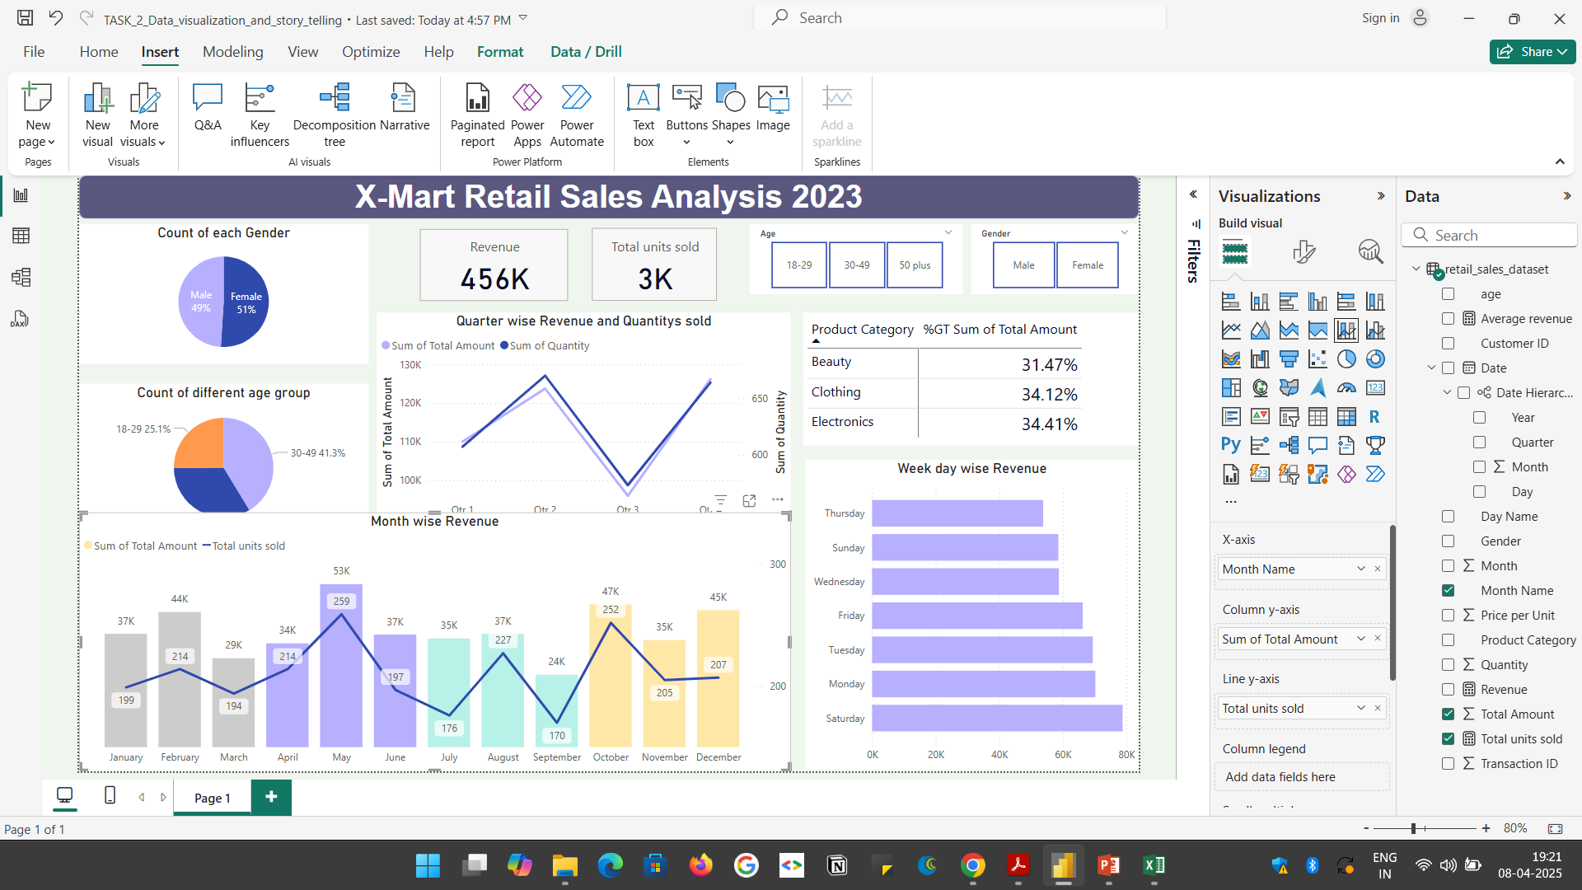
Data Analysis
How much each category contributing to the 2023 revenue? Also find the age group wise purchasing behaviour.
Highest revenue is generated from the sales of beauty products and cosmetics. Around 35% of the revenue comes from ‘Beauty’ category.
In the age group of ’18-29’; the highest purchasing category is ‘Clothing’. More than 37% of revenue generated from the clothing purchase of youngsters.
In the age group of ’30-49’; the highest purchasing category is ‘Beauty’. More than 36% of revenue generated from the cosmetic purchase of the customers in the age of 30-49.
Customers who are in the age group ’50 plus’ purchase more Electronic products(43%)

Slide 7
Data Analysis
Analyse the sales in the weekends.
Among the weekends Saturday and Sunday, Saturdays are the most revenue generating day. The average revenue in Saturday is nearly $80000
The second most sales generating day is Monday. The average Monday revenue is around $70000
The least revenue day is Thursdays and Sundays

Slide 8
Insights and Recommendations
Majority of the customers are in the age group of 30-49. And the least is in the group 18-29. Introduce more youngster attracting products in all categories.
Use unique Social media marketing strategies to attract youngsters
Third quarter (July, August, September) is the least revenue generating. Introduce offers, discounts and campaigns on those months.
August and march is the least revenue generating months. Attract more customers by giving ‘Independence day special offers’ in August and ‘Women’s day special offers’ in March.
Improve the customer service and customer feedback to create a good impression in customers

Slide 9
Thank You
Biji T J
Elevate Labs

